Slide 1
Sleep capsules for MIPT
Krutikov Dmitry B01-109

Slide 2


Slide 3

Sleep is an effective way to recover

Slide 4
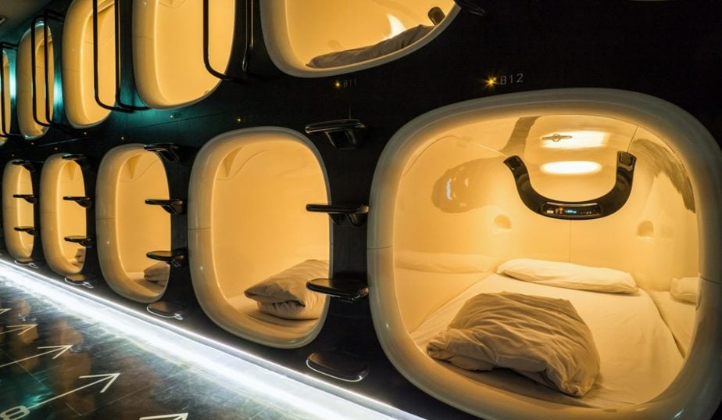
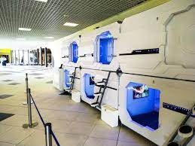
Sleep capsules

Slide 5
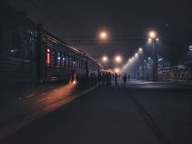
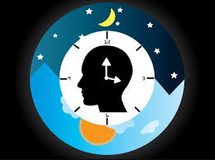
What are the benefits?
1) not need to return home at night
2) one hour of sleep in a capsule is equal to two hours of normal sleep

Slide 6
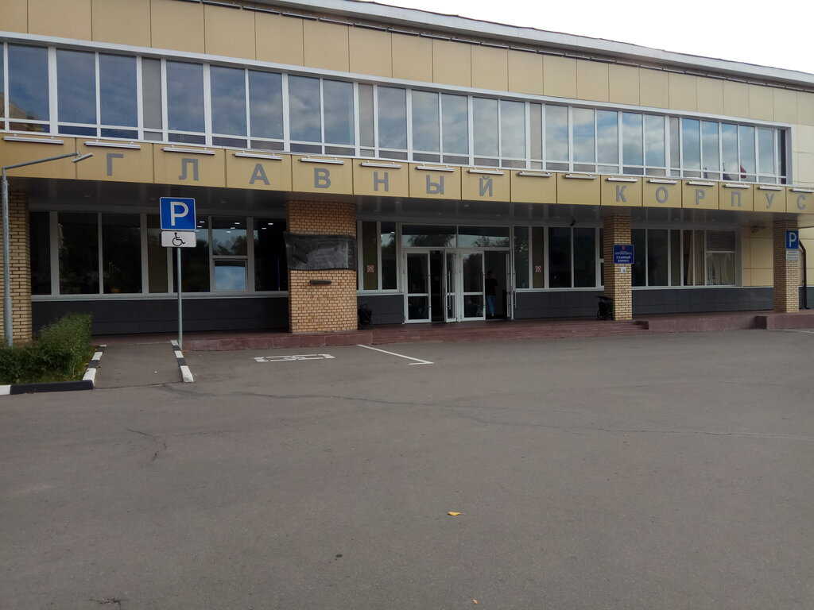
Best place

Slide 7
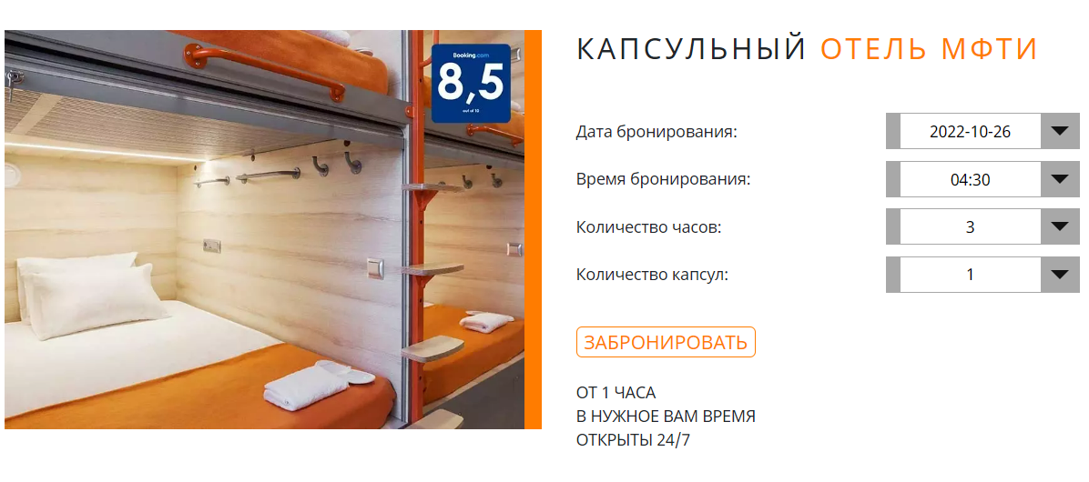
Booking via website

Slide 8


